Slide 1


Analysis and Prediction of Cost of Attendance using CRISP-DM
Sri Lakshmi Tammineni - 11482201
SriLakshmiTammineni@my.unt.edu
Anusha Putta - 11500342
AnushaPutta@my.unt.edu
University of North Texas-Denton

Slide 2
Abstract
The aim of the project is to apply our design and understanding of various data extraction, cleaning, analysis and modeling techniques learnt during the length of our course and evaluate the dataset provided.
For the purposes of our project, we are analyzing the Cost of Attendance data set provided in our Data Sources section of the course project.
The dataset consists of 1368 observations with 65 variables describing each observation.
The data consists of observations both from undergraduate and graduate levels of education.

Slide 3

Method and Brief Review of CRISP-DM
Cross-industry standard process for data mining, known as CRISP-DM, is an open standard process model that describes common approaches used by data mining experts.
A CRISP-DM project has 6 major phases
Business Understanding
Data Understanding
Data Cleansing and Preparation
Modelling
Evaluation
Deployment

Slide 4
Business Understanding
In this initial phase of the project, we would like to understand the determinant variables or factors that influence the overall cost of attendance. Once these variables are identified, we were able to put forward the following question and try to answer them based on the results of our analysis:
Can we predict the future cost of education?
Which components of college cost should students concentrate on to reduce expenses?
Can our prediction help future students in choosing a college experience with reasonable costs?

Slide 5
Data Understanding
During the data understanding phase of the project, we acquire the dataset and try to identify the variables that are significant. In this process, we shortlist a set of 28 variables which we believe are significant for the purposes of analysis. Also, we choose to analyze only data about full-time students. Hence, any variables representing part-time students have been omitted. Below is the list of variables that we have shortlisted for exploratory data analysis (Years 2016-2019):
University ID
Published In-state and out-of-station Tuition and Fees
Books and Supplies
On and Off campus, room, and boarding
On and Off campus other expenses
471 %

Slide 6
Data Cleansing and Preparation
We need to construct the final dataset from the raw dataset by formatting the data as below:
We choose to consider only full-time students for the purposes of this study.
We choose to consider both in-state and out of state tuition students.
We choose to consider only on-campus students and off campus students not living with family. These use cases we believe cover a significant number of students and these choices would narrow our problem to be analyzed effectively.
We created a new categorical variable named ‘Year’ to highlight the academic year and re-ordered the data to combine columns of the same data into a single column with the year as identifier.
Missing data values for single cells in the data are populated with linear estimates. Also, for institutes with only one type of housing we duplicated the housing cost data for housing types that are unavailable.
Finally, for ‘Books and Supplies’ empty cells are populated with the mean of all other institutes’ data for that academic year.

Slide 7
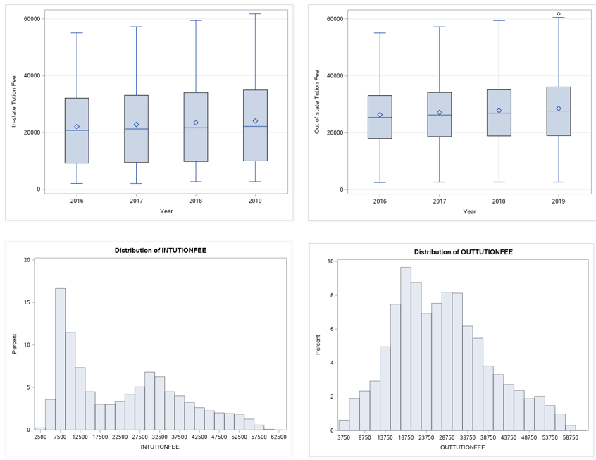
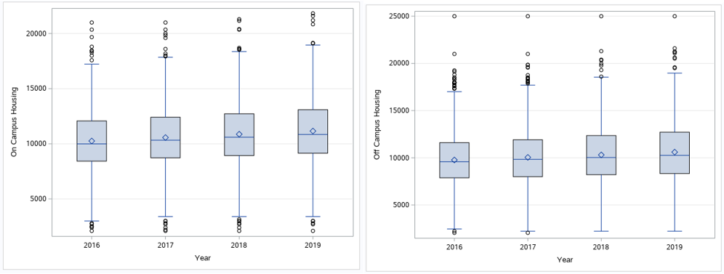
Bar charts and Histogram for In-state and out of state tuition
The above box plots are of in-state and out-of-state tuition fees. They are two of the most significant variables in the Cost of Attendance metric; both are on an upward trend.
This upward trend is mimicked by the trend of rising housing costs of both on-campus and off-campus housing options available to students. However, it should be noted that the rate of increase is higher in on-campus housing compared to off-campus options.
The other variables like Books and Supplies and Other Expenses do not follow this pattern.
Box plots for On and Off campus Housing

Slide 8

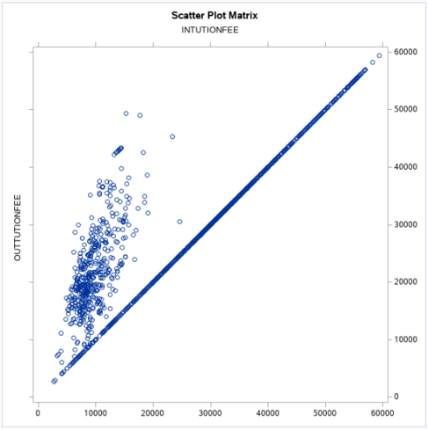
Modelling
1. ANOVA to identify the determinants for Cost of Attendance.
We perform correlation analysis and One-way ANOVA to identify the relation between the 7 variables deemed as significant and analyze our findings. Below are the charts and observations from Correlation analysis and ANOVA performed in SAS Studio
This Fig shows the relation between In-state and out-of-state tuition fees. They have an almost linear relationship with out-of-state tuition having outliers with a great rise in costs compared to that of in-state tuition.
Correlation Analysis between In-State vs Out-of-State Tuition

Slide 9
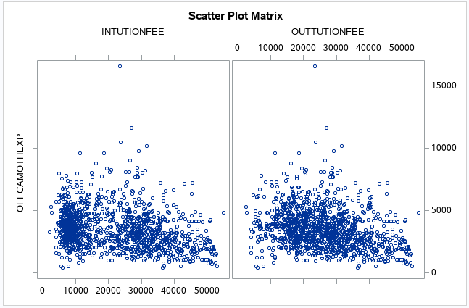
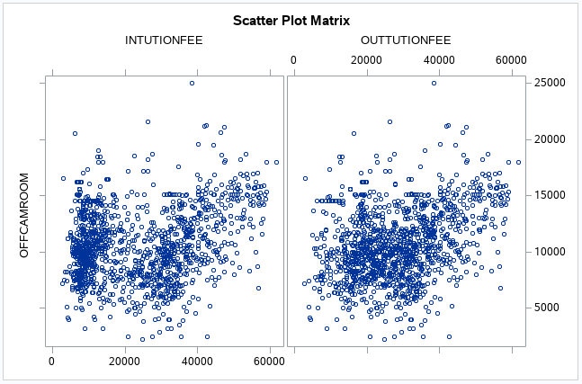
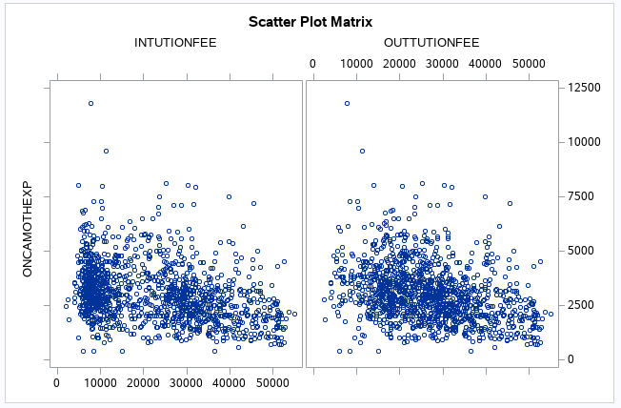
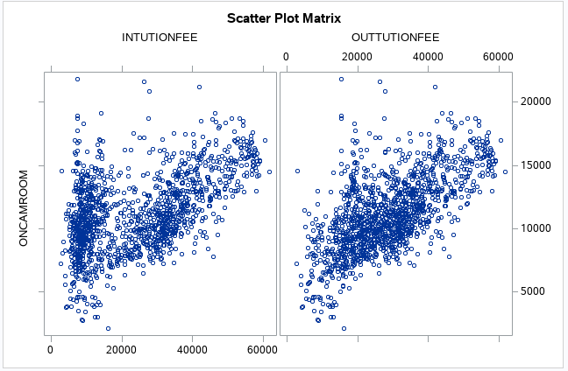
Correlation Analysis between Off-Campus Expenses vs In-State & Out-of-State Tuition
Correlation Analysis between Off-Campus room vs In-State & Out-of-State Tuition
Correlation Analysis between On-Campus Expenses vs In-State & Out-of-State Tuition
Correlation Analysis between On-Campus room vs In-State & Out-of-State Tuition

Slide 10
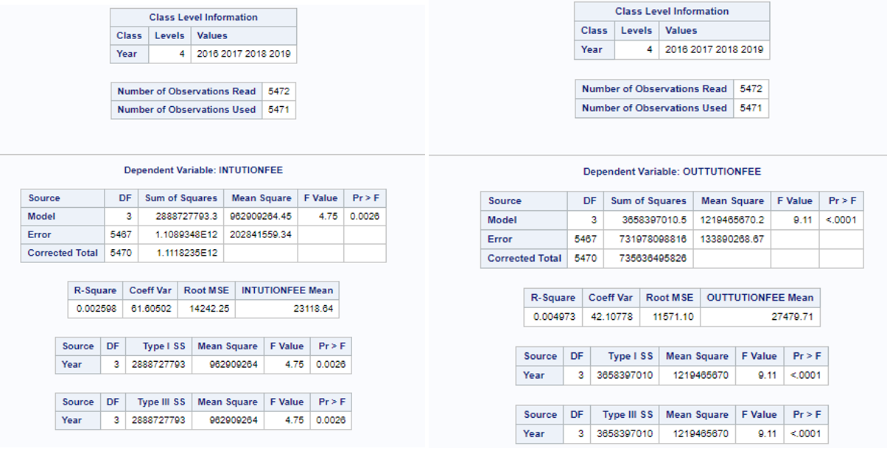
One way ANOVA was performed on all the seven variables and results of the analysis showed that means of in-state and out-of-state tuition have changed over the four-year period and in an upward trend. Results of the analysis are in above screenshot. Note the low P value < 0.05 significance. With a null hypothesis that each of the expenses has been the same across 4 years, the value of P proves or disproves the null hypothesis.
Result of ANOVA for In-state and out-of-state tuition

Slide 11
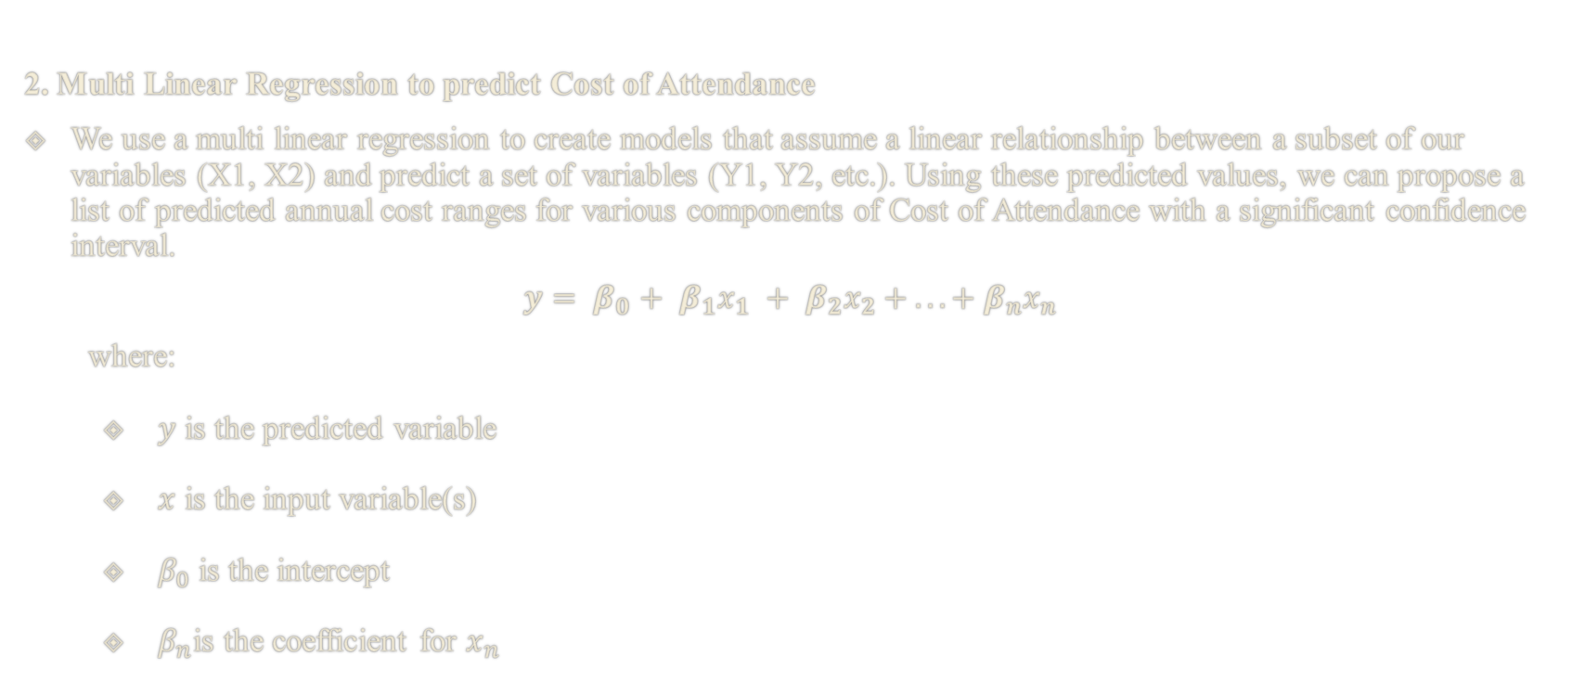
Continuation of Modelling…
2. Multi Linear Regression to predict Cost of Attendance
We use a multi linear regression to create models that assume a linear relationship between a subset of our variables (X1, X2) and predict a set of variables (Y1, Y2, etc.). Using these predicted values, we can propose a list of predicted annual cost ranges for various components of Cost of Attendance with a significant confidence interval.
$$y= β_{0}+ β_{1}x_{1} + β_{2}x_{2} + ... + β_{n}x_{n}$$
where:
$y$ is the predicted variable
$x$ is the input variable(s)
$β_{0}$ is the intercept
$β_{n}$is the coefficient for $x_{n}$

Slide 12
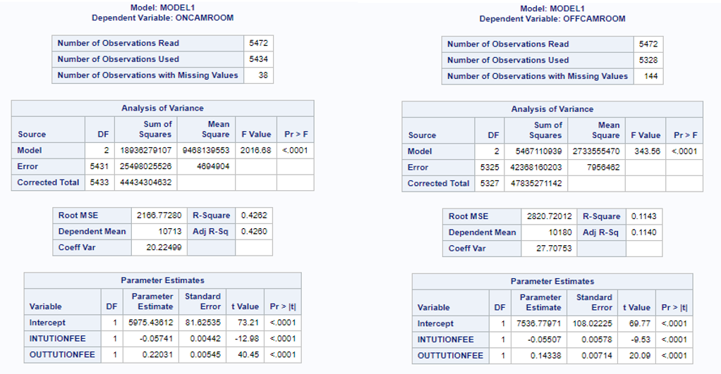
For this linear regression model creation, we use Linear regression model defined in the sklearn module of Python. We create two subsets of the data for model creation and validation purposes. We consider the in-state tuition and out of state tuitions as the input variables and we predict the remaining components of the cost i.e., output variables. Above screenshot shows a similar regression results performed in SAS Studio. As the only variables that are correlated to two tuition components are the housing costs (on-campus and off-campus) we have these variables predicted using the regression model. Both books and supplies and other expenses costs can be estimated within 95% confidence using the range trend of these variables.
Results of Multi-linear regression

Slide 13
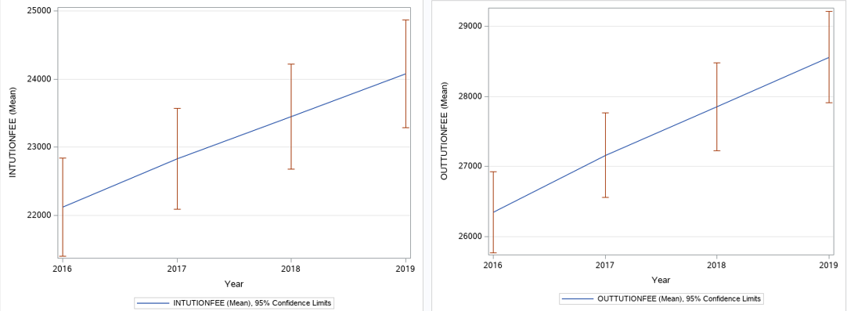
Evaluation
To evaluate the overall fit and accuracy of our Linear model we use the train/test split method by splitting data into two subsections.
When interpreted in the context of our source data Root SME value are ~2100.Also, the R-squared value is between 0 and 0.6 showing our model ability to predict values with reasonable confidence.
The summation of the resulting primary and secondary variables should give us an estimate of total cost of attendance for college into the future. Based on our extrapolations we have an estimated in-state tuition range of [$23654, $25726] and estimated out-of-state tuition range of [$29410, $31630] with an approximate confidence range of 95%.
Cost patterns for tuition fees and 95% confidence interval for each

Slide 14
Deployment
Deployment is the process of using your new insights to make improvements within your organization. In general, the deployment phase of CRISP-DM includes two types of activities:
Planning and monitoring the deployment of results
Completing wrap-up tasks such as producing a final report and conducting a project review
In our case, as this is just a study of data and summarizing our observation and results, we do not have this component in our project scope.

Slide 15
Discussion of Findings
1. Can we predict the future cost of education?
Based on our analysis and findings we see that the features in-state and out-of-state tuition have the highest significance among all considered features. Hence it is related to the cost of attendance calculation. The scatter plots in the above slides indicate the presence of absence of relationship between the various features considered.
2. Which components of college cost should students concentrate on to reduce expenses?
Based on our analysis of data, the significant components of cost of education are tuition cost and housing costs. Students should try to concentrate on ways to decrease tuition component either by available scholarship or assistantships to decrease the tuition costs.
3. Can our prediction help future students in choosing a college experience with reasonable costs?
Choosing In-state college
Choosing off-campus housing

Slide 16
References
IBM SPSS Modeler CRISP-DM Guide, IBM Corporation 2011.
URL: https://inseaddataanalytics.github.io/INSEADAnalytics/CRISP_DM.pdf
Gregory Piatetsky, CRISP-DM, still the top methodology for analytics, data mining, or data science projects (2014).
URL: https://www.kdnuggets.com/2014/10/crisp-dm-top-methodology-analytics-data-mining-data-science-projects.html
CRISP-DM - Data Science Process Alliance
URL: https://www.datascience-pm.com/crisp-dm-2/
Data Mining using CRISP-DM methodology
URL: https://www.section.io/engineering-education/data-mining-using-crisp-dm-methodology/
Using CRISP-DM to Predict Car Prices
URL: https://medium.com/@christophberns/using-crisp-dm-to-predict-car-prices-f15eb5b14025

Slide 17

Thank you

